Slide 1
My favourite animal!

Slide 2
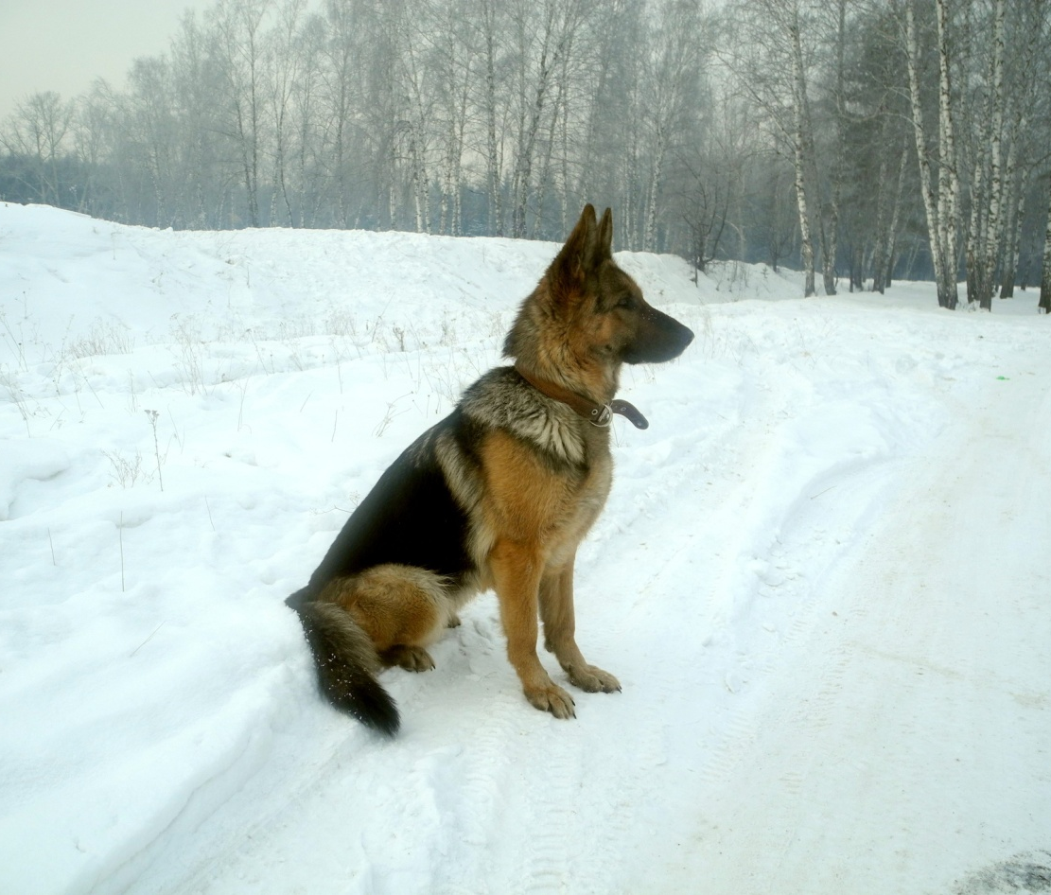
My favourite animal is dog.

Slide 3
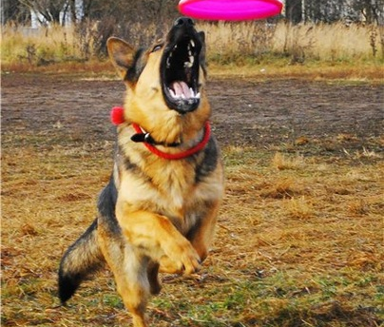
Dogs like to play with a ball and a disk.

Slide 4
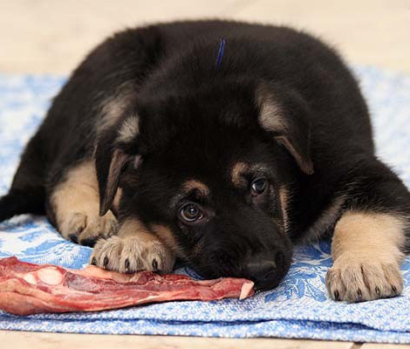
What do they like to eat? They like meat, bones, sausages.

